Slide 1
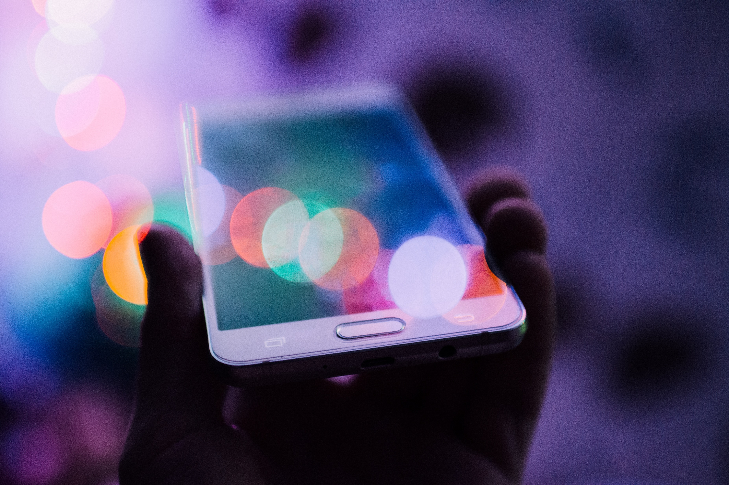
THE DIGITAL BUSINESS
THE DIGITAL SOLUTION
Created by
Barbora Gallova
Sabina Sandorova
Nicoleta Smolkova
Bernarth Kones
JUST Jevgenia

Slide 2
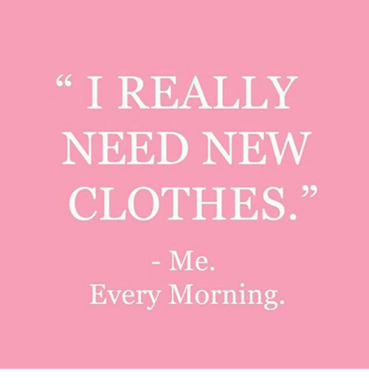

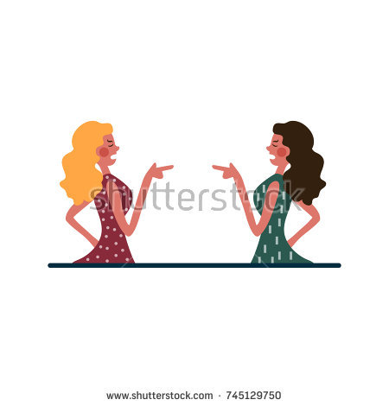


IDEA?

Slide 3
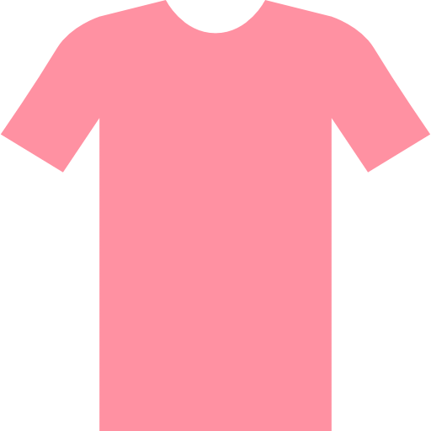




The idea of the app is to match particular item with other clothes and to show the location of stores where it’s possible to find and buy it. Our aim is to make shopping for our users faster and more pleasant.
What do we want to achieve?
1. Easy shopping for our users
2. Collaboration with different fashion brands
3. Popular fashion social network
4. Raise of GDP of Denmark in fashion sector

Slide 4
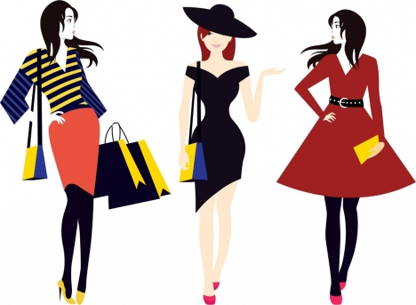
TARGET AUDIENCE
Living in Denmark
Young women age 21-24
Men
Mothers
Students
Notes:
Young women living in Denmark age 21-24.
Men – they usually don’t enjoy endless shopping.
Any age range

Slide 5
HOW WE APPEAL?
modernity
easy access
usability
communication between users
stylish design
simplicity

Slide 6
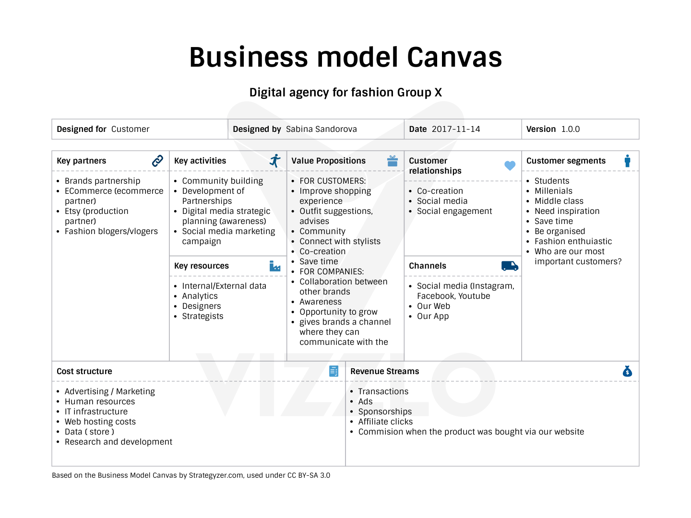

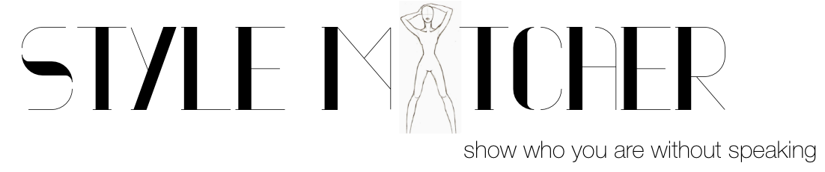

Slide 7
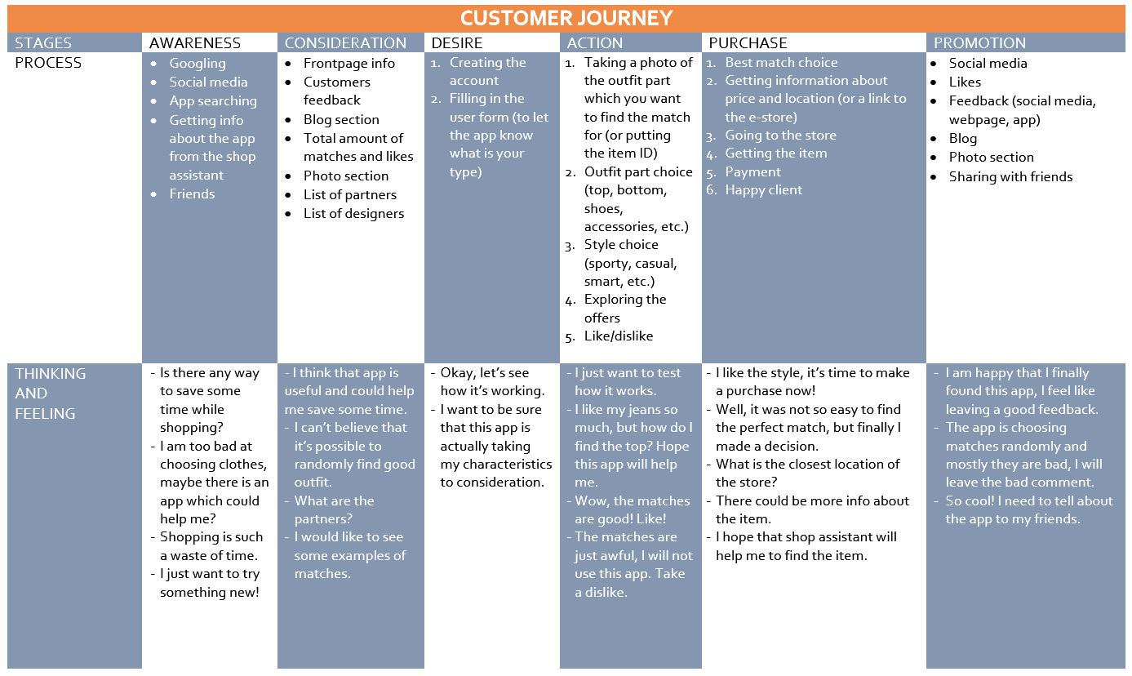
CUSTOMER JOURNEY

Slide 8
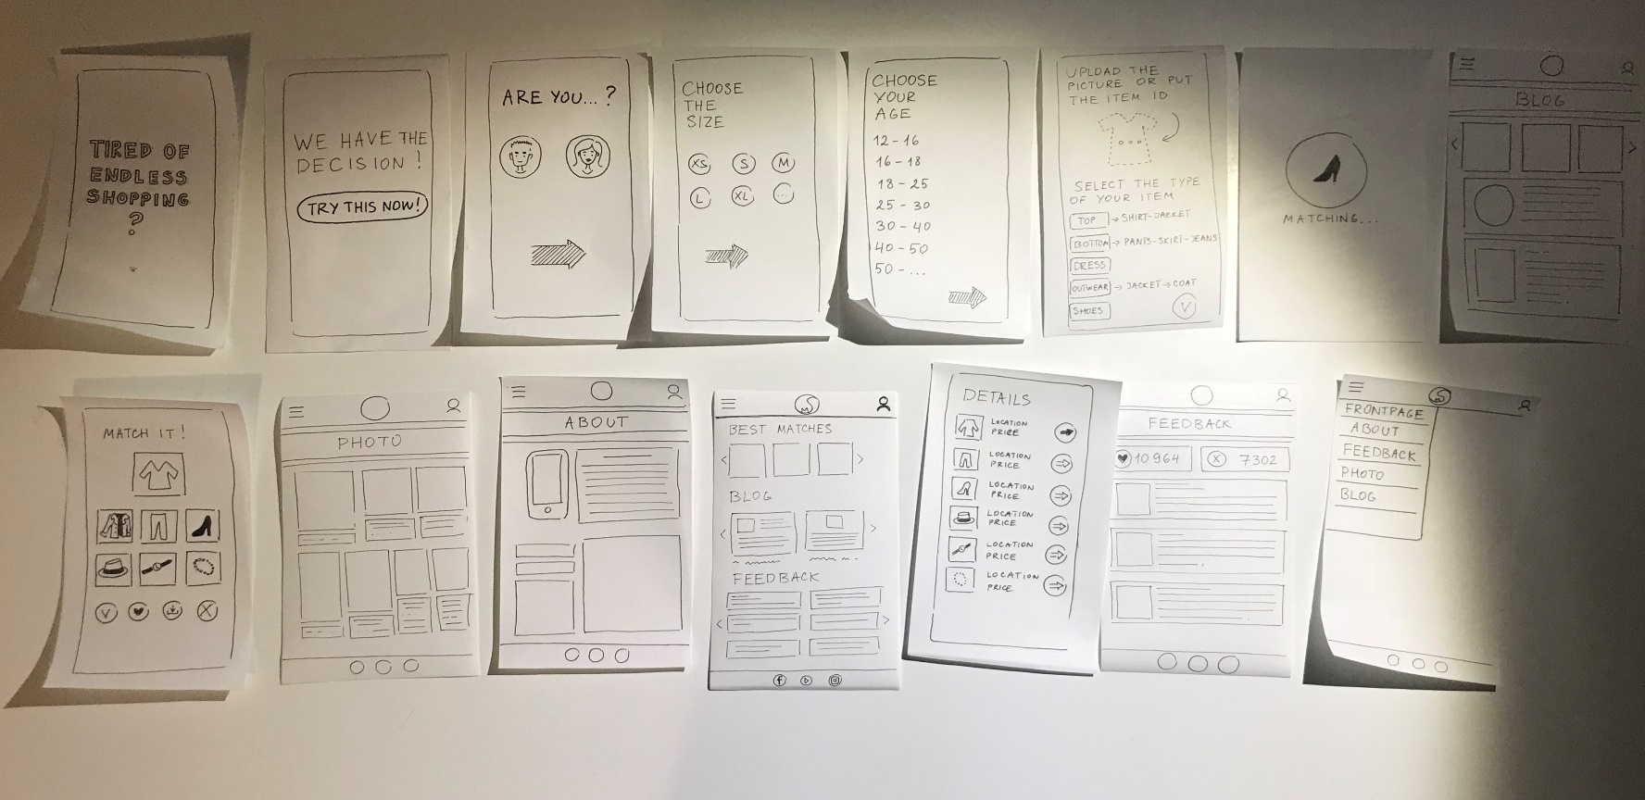
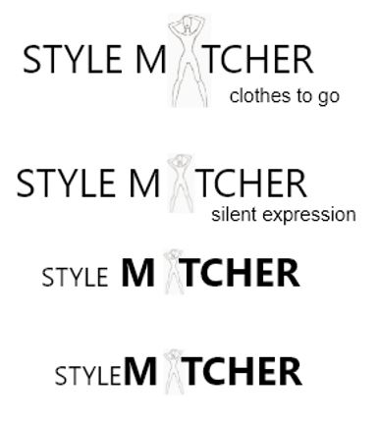



DESIGN PROCESS

Slide 9



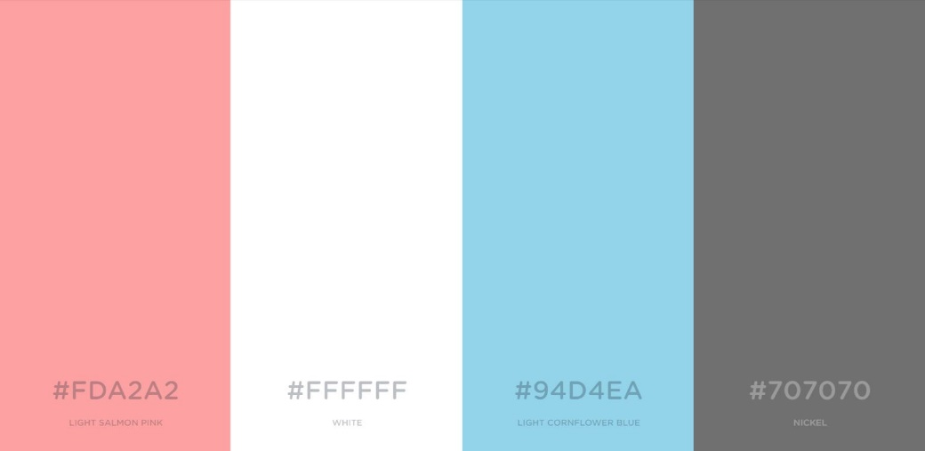
DESIGN CHOISES
Logo
Typography
Colour scheeme
Notes:
DESIGN Visual Identity Our main target audience is mostly girls and we wanted to create something sweet and funny. We have developed the visual identity with a help of colours (pink and blue), which are popular among women, our logo is also more feminine, because it’s pink and has smooth lines,

Slide 10

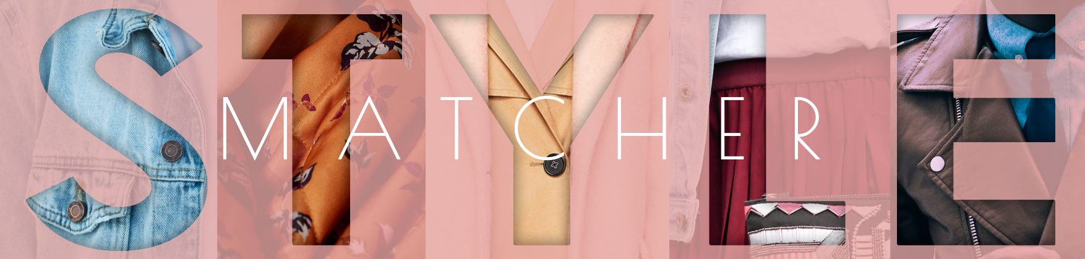
DESIGN ELEMENTS

Slide 11
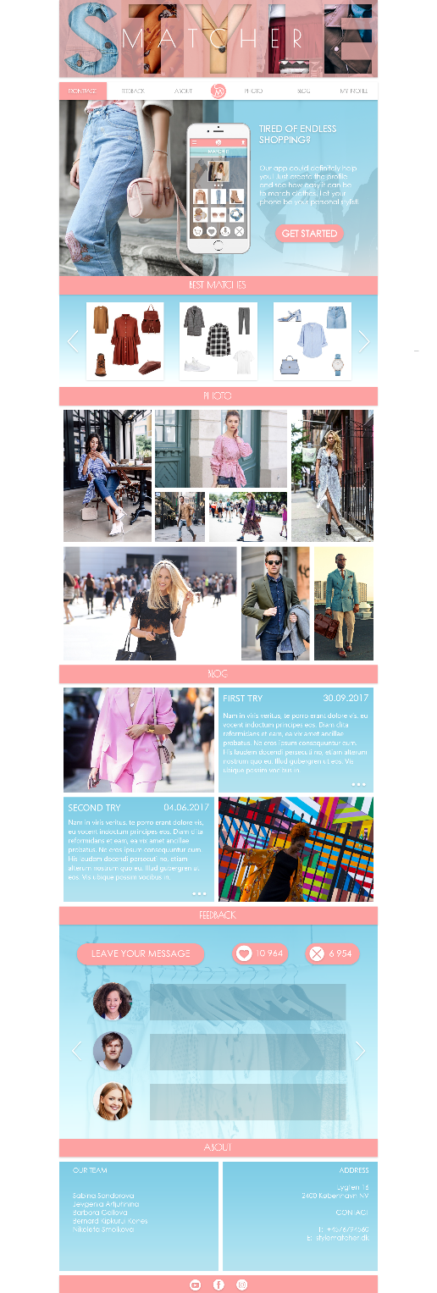
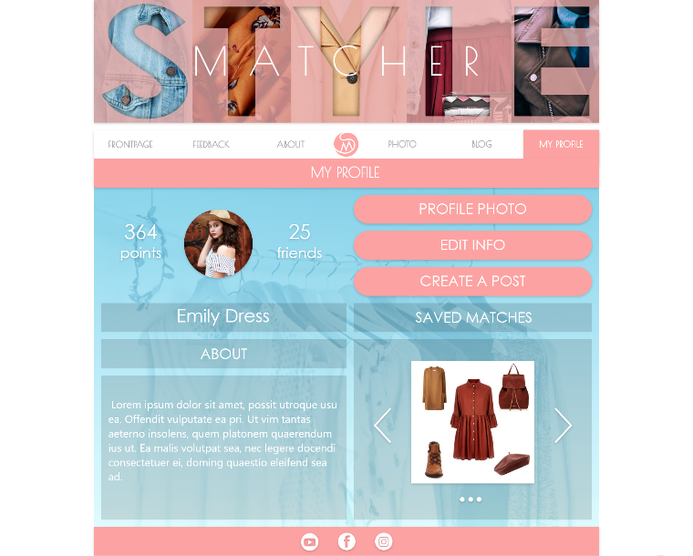
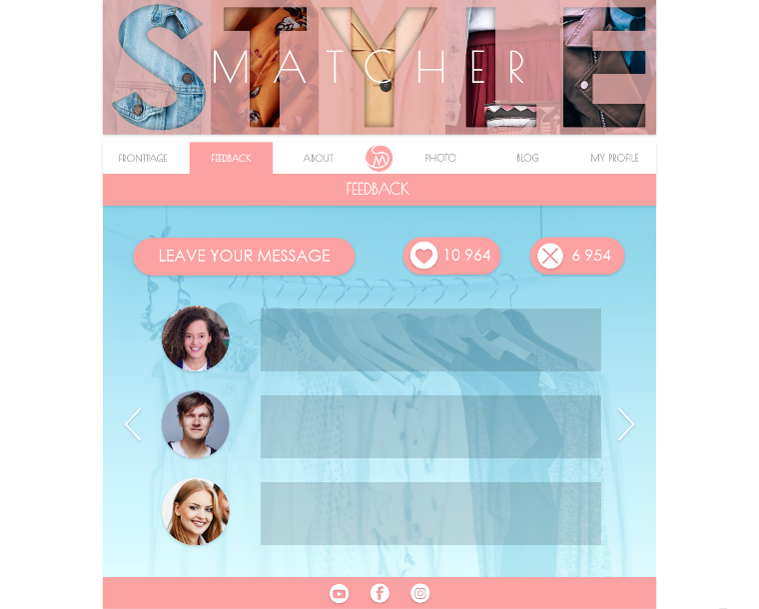
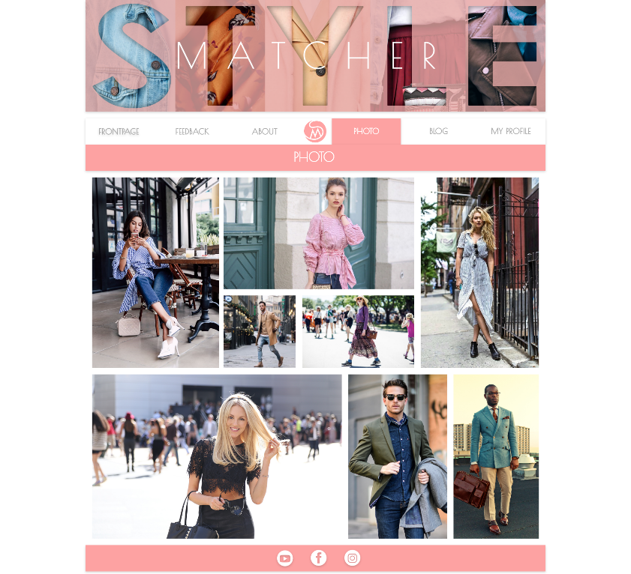
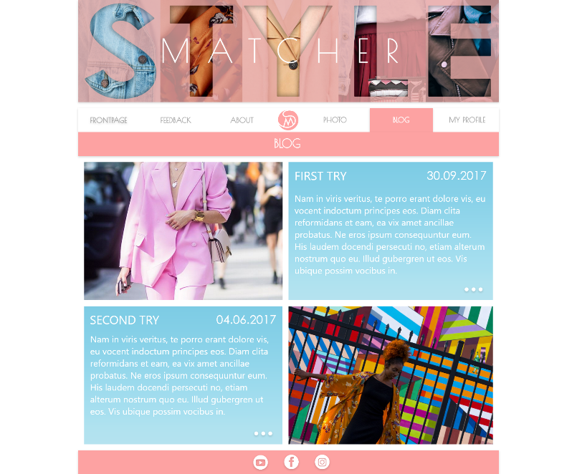
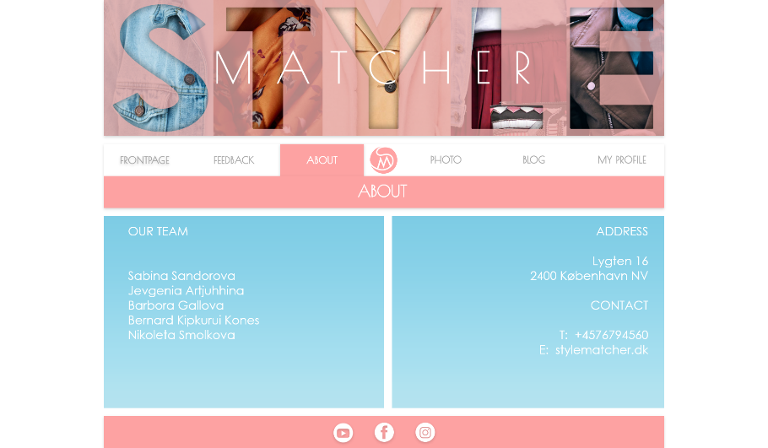
WEBSITE PROTOTYPE
http://einylune.eu/stylematcher/index.html
https://xd.adobe.com/view/6e237628-a9a4-441c-80e5-78699c32d2ee/
Notes:
the content we used on our webpage is also more for girls. In addition our app has some social network features, which can be interesting for women as blog and profile page with such features as friend list and score. It is easy to see what is our app about because of its content (fashion pictures, blogs) and design elements (colors, icons, lines, logo, cover picture on the webpage

Slide 12


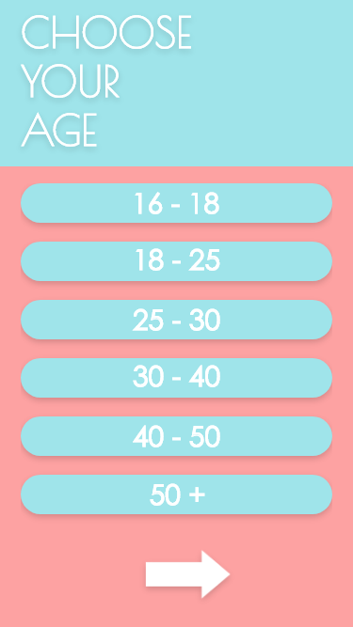
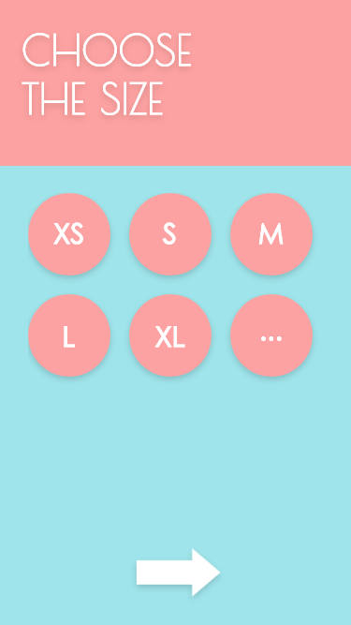
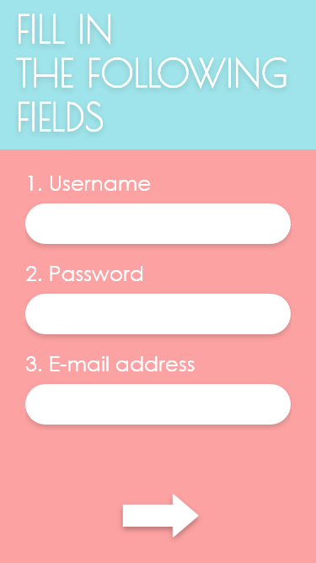
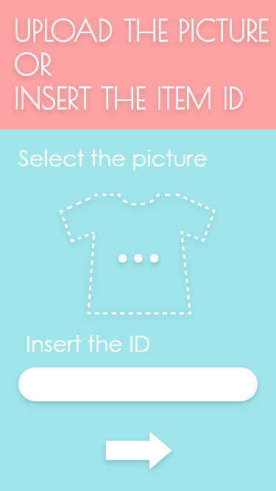

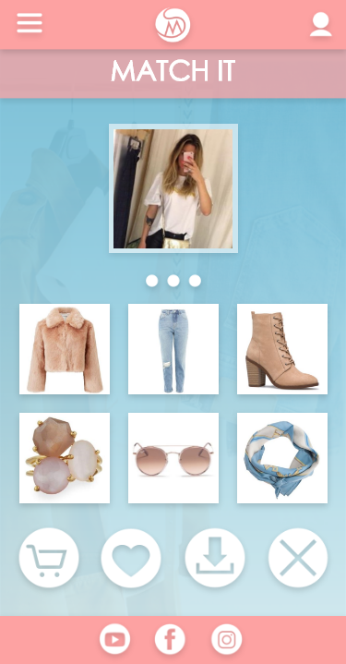
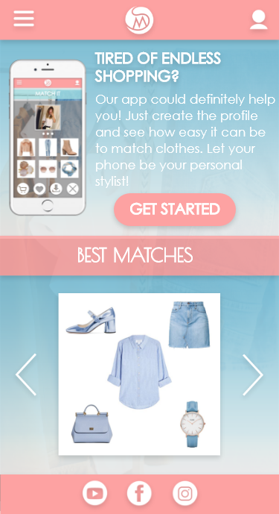
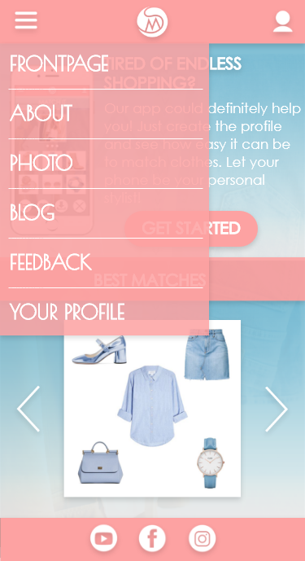
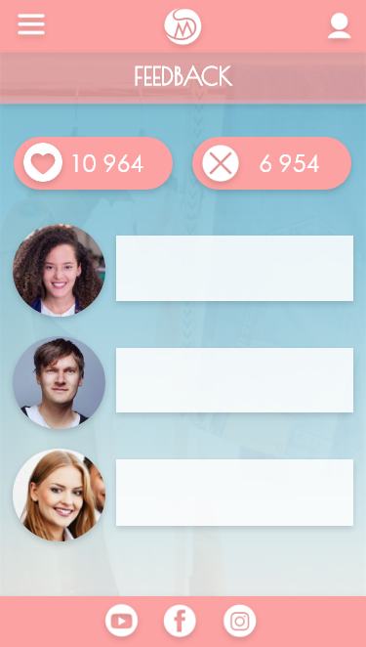
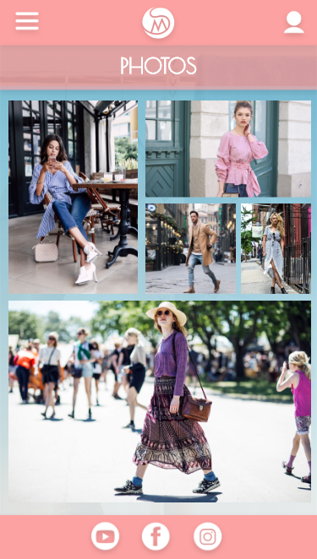
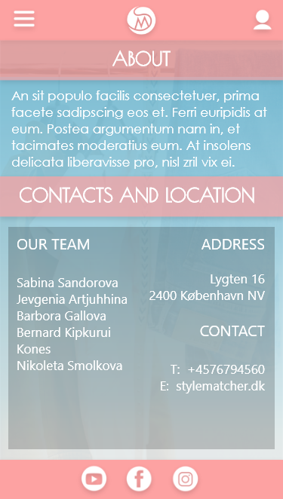
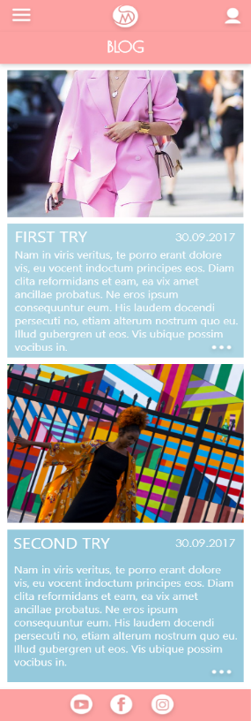
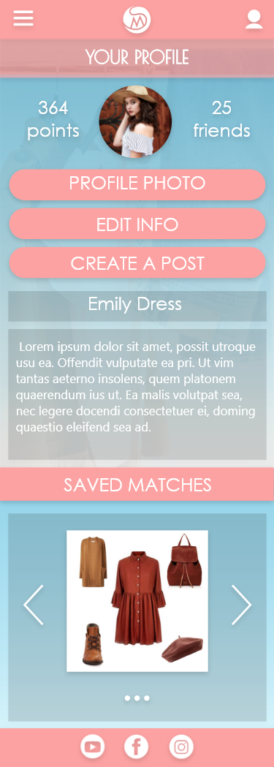
APP PROTOTYPE
https://xd.adobe.com/view/11254f2f-9200-4557-a0f2-54b0bcb1394a/

Slide 13
Thank you.

